Slide 2

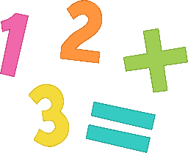

A number pattern is a sequence of numbers that follow a certain rule.
This is a number pattern:
1, 2, 3, 4, 5, 6
The rule is add 1 each time
Click here to see how this works.

Slide 3
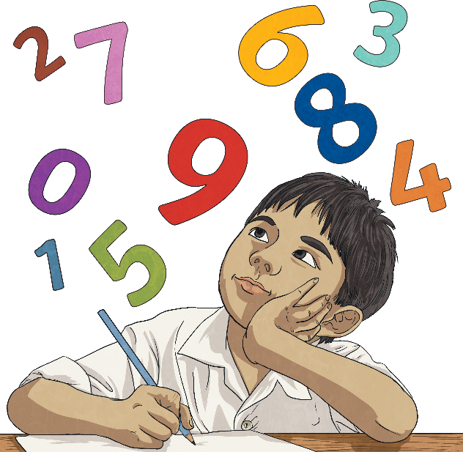
What would the next number be in this pattern?
1, 2, 3, 4, 5,
+1
2
+1
+1
+1
+1
3
4
5
6
1 + 1 = 2
2 + 1 = 3
3 + 1 = 4
4 + 1 = 5
5 + 1 = 6

Slide 4


What is happening each time?
5, 10, 15, 20, , ,
+5
+5
+5
25
30
35
Can you figure out what the next numbers in this sequence would be?
35 + 5 = 40

Slide 5
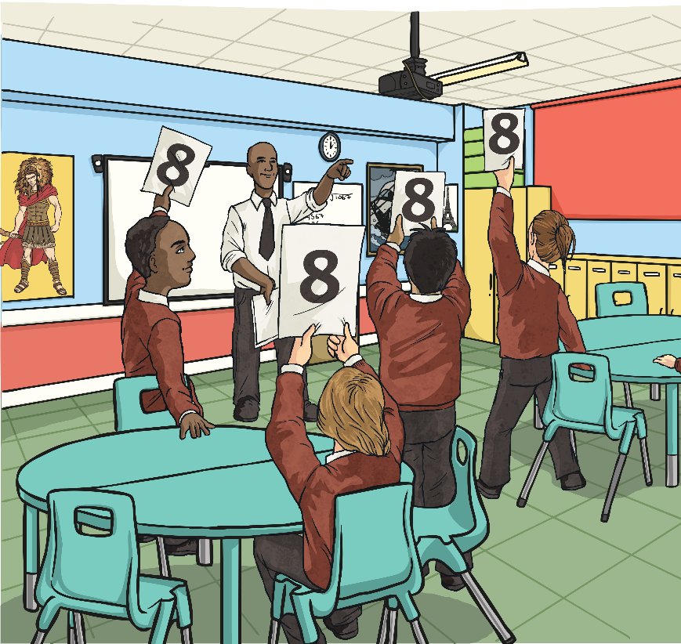
Number sequences can use addition, subtraction, multiplication or division.
Each rule can include whole numbers or decimal numbers.
+
-
Let’s look at some trickier sequences!

Slide 6

Can you finish this number sequence?
48, 47, 45, 42,___, ___.
-1
-2
-3
-4
-5
38
33
What happens to get from 48 to 47?
What happens to get from 47 to 45?
What happens to get from 45 to 42?
What number will come after 42?
What number will come after 38?

Slide 7
Now, can you figure out the missing numbers and the rule in these sequences?
13, 17, 21,___, ___
25
29
rule = add 4
95,___, 75, ___, 55, 45, ___
85
65
35
rule = subtract 10
10.1, 11.2, 12.3,___, ___, 15.6
13.4
14.5
rule = add 1.1

Slide 8
Let’s look at these even trickier number patterns. Can you figure out the missing numbers and the rule in these sequences?
2, 4, 8, 16, ___, 64, ___
32
128
rule = double the number
800, ___, 200, 100, 50, ___
400
25
rule = divide by 2
10, 17, 20, 27, 30, ___, ___
37
40
rule = add 7, add 3

